Slide 1
Design Patterns In Real Life
Sarir Khamsi
30 Nov 2004
Prepared for
University of Arizona

Slide 2
Overview
Why use patterns
  Will this be on the exam
Well documented patterns
  Singleton
  Bridge (aka compiler firewall, pImpl [sic] idiom, handle/body, letter/envelope)
  Command, with a twist
  Factories (creation and cloning)
Conclusion and deep thoughts
Additional material
  C++ Standard Template Library (STL)
  Testing and you

Slide 3
It Would Help If You Knew
Object-Oriented (OO) methodologies
  Including inheritance, runtime polymorphism, encapsulation, etc.
An OO language, like Java or C++
The Unified Modeling Language (UML) class and sequence diagrams
How some of these patterns have been implemented

Slide 4
Why Use Patterns
You might be asking, “Why do we have to learn this crap?”
Well...
Other experts have experienced reoccurring patterns in several software projects
These patterns have been collected and named into a single resource
Using well-documented patterns will
  Save time in having to design them yourself
  Convey designs w/ more common terminology
    Think of them as standardized interfaces
  Impress your boss

Slide 5
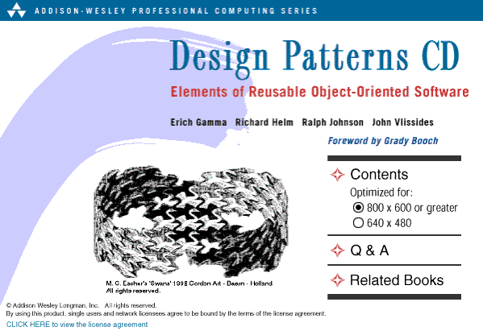
Gang of Four Book

Slide 6
Gang of Four Book
Design Patterns: Elements of Reusable Object-Oriented Software, by Gamma, Helm, Johnson, and Vlissides
Main pattern categories: creational, structural, and behavioral
This is design reuse
  Why reinvent something when it’s already been done?

Slide 7
Some Patterns I’ve Used

Slide 8
Singleton Pattern
Intent
  Ensure a class only has one instance, and provide a global point of access to it
Main reason for being
  Prevent multiple instances from being created
  Provide a single instance of a resource’s interface
  Nice side effect: you are able to access the object from any region of code with having to pass the object around
Examples
  Error log, database, device controller
  We don’t want multiple instances competing for the same resource

Slide 9
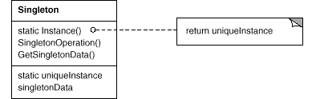
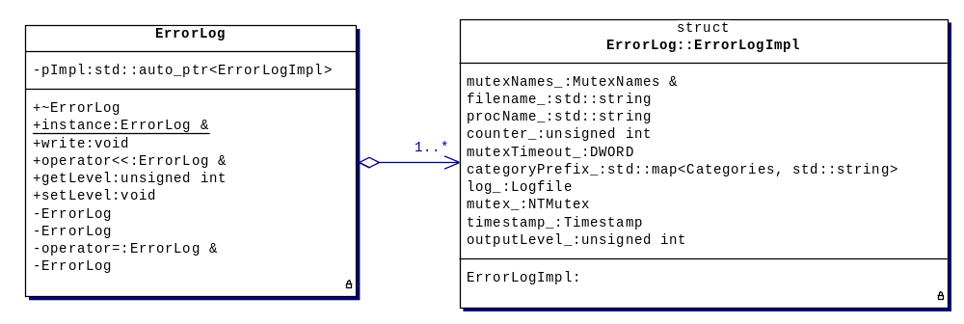
Singleton Pattern
GoF version
My version

Slide 10
Singleton Implementation
// in Java
public class Singleton {
static public Singleton instance() {
if (null == instance_) {
instance_ = new Singleton();
}
return instance_;
}
protected Singleton() {
// ...
}
static private Singleton instance_ = null;
}
Notes:
// in C++
class Singleton {
public:
static Singleton &instance() {
static Singleton singleton;
return singleton;
}
// other interesting member functions
private:
Singleton() { }
Singleton(const Singleton &copy);
Singleton &operator=(const Singleton &rhs);
};
// usage
Singleton cantDoThis; // error!
Singleton &s = Singleton::instance();
// call members on s

Slide 11
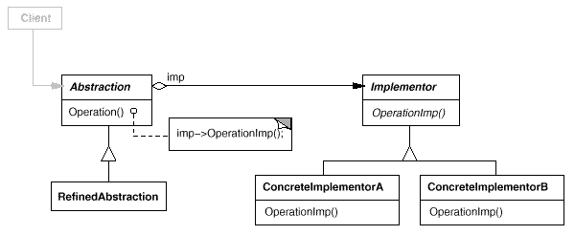
Bridge Pattern
Intent
  Decouple an abstraction from its implementation so that the two can vary independently

Slide 12
Solution Implementation 1.0
// in Bridge.hpp
class Bridge
{
public:
Bridge();
~Bridge();
// your fancy member function(s)
void printAndInc();
private:
// no other member data!
struct Impl; // forward declaration (yet to be defined)
Impl *pImpl; // declare opaque pointer
};

Slide 13
Solution Implementation 1.0
// in Bridge.cpp
#include "Bridge.hpp"
#include <iostream>
struct Bridge::Impl {
Impl() :
i(0) { }
int i; // the member data for Bridge
};
Bridge::Bridge() :
pImpl(new Impl) {
}
Bridge::~Bridge() {
delete pImpl; // clean up
}
void Bridge::printAndInc() {
std::cout << "value = " << (pImpl->i)++ << std::endl;
}

Slide 14
Command Pattern

Slide 15
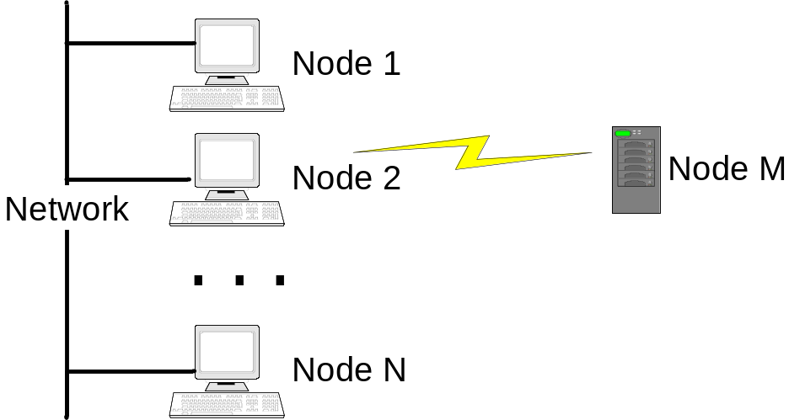
System Overview
We had a collection of networked ground computers and something flying through the air
System behavior governed by events that generate messages
  User input and/or timed events
Appropriate action is taken on message reception
Requirements volatility was high since it was a new demo program
  This was a fact of life and complaining didn’t help (though we tried)
A flexible architecture was needed to respond well to changes

Slide 16
Requirement & Architecture
In a broad sense, requirements embedded in the architecture can be problematic
  If a requirement changes and forces an architecture change the impact could be huge
OO techniques can help separate the two^{[1]}
  Encapsulation, polymorphism, and design patterns play vital roles in the separation
    C++ supports all of these features
Software designers need to...
  Come up with a design :-)
  Manage variability

Slide 17
Managing Variability
Encapsulation
  By keeping data private, a class isolates its clients from variations in the implementation details
Polymorphism (or dynamic/late binding)
  Let the runtime system determine the dynamic type of the object
  Behavior can change at runtime
Design patterns^{[2]}
  Incorporate well-published, widely known, & proven design elements with explicitly-declared variation points and variation dimensions
Separation of concerns
  Decompose system into subsystems, classes and class hierarchies
C++ Standard Template Library (STL)^{[3]}
  The STL supplies developers with many generic containers, iterators, and algorithms allowing variation on types
These variation mechanisms enable us to program at higher levels of abstraction
Notes:
The STL is part of the Standard C++ language. Because it is a template library, its containers, iterators, and algorithms can operate on arbitrary types.

Slide 18
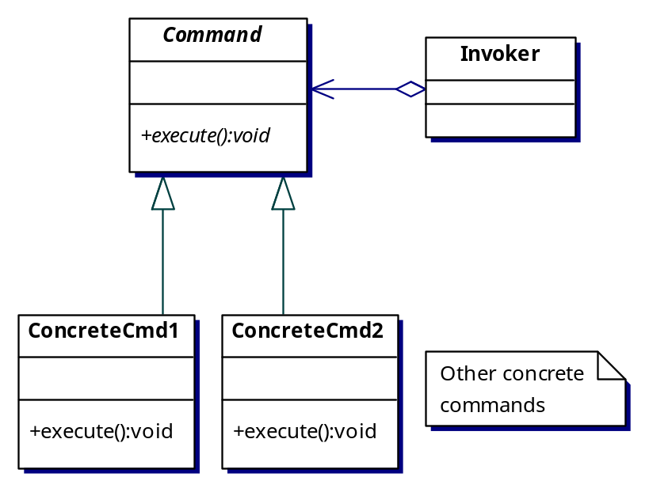
A Solution Looking for a Problem
In a previous project, the “command” design pattern^{[2]} looked intriguing
  Real, or concrete, commands are delegated to derived classes
  The execute() member function encapsulates the real work for the derived command, localizing code
  Routines could operate on general Commands without knowing the actual, or concrete, command (via runtime polymorphism)
Notes:
The example used in [2] describes a menu system of a GUI where the user selects menu items. Here, the actions performed are placed in derived Command classes.

Slide 19
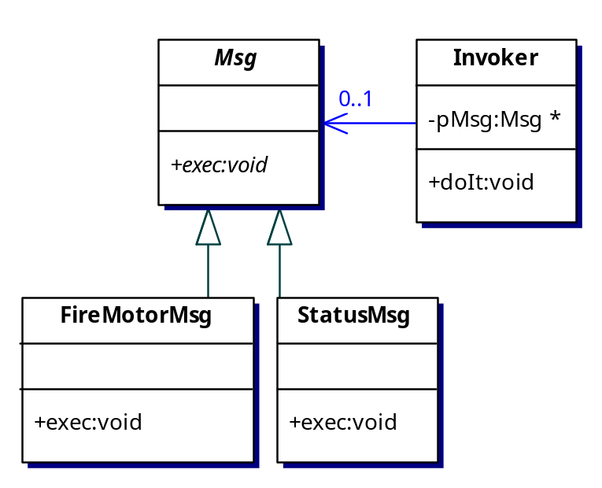
Isolating Requirements
The command pattern was then adapted for messages
Derived message classes were “executed” once received
Message action code (fulfilling a requirement) was localized in the exec() member function
The architecture was designed to operate only on the Msg base class
  Message manager became trivial
    Wait for message ready semaphore, pull a message off the queue, call the exec() member function
Almost all requirements were placed in derived message classes
...
void Invoker::doIt() {
pMsg->exec();
}
Notes:
Most of the project’s requirements related to action taken is based on message reception. A user, sitting at a GUI, would issue a command and in turn generate a message.

Slide 20
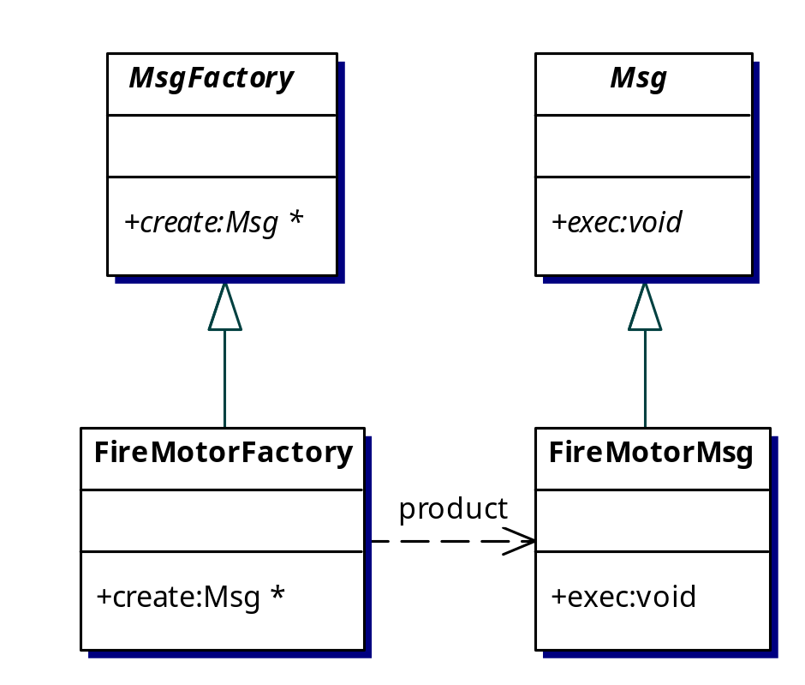
Message Creation
Incoming messages are inspected for an ID via independent “read” threads
The ID is used as an index into a message factory lookup table
The message factory knows how to create the corresponding concrete message
The corresponding message is created, placed on a queue, and a message ready semaphore is set
Notes:
A message factory was needed because it was possible that the same massage would be received before the first one was done being processed. It would have been possible to create a pool of messages – along with several duplicates – but a message factory did not cause any problems and was not a performance bottleneck (even with message being created dynamically on the heap).

Slide 21
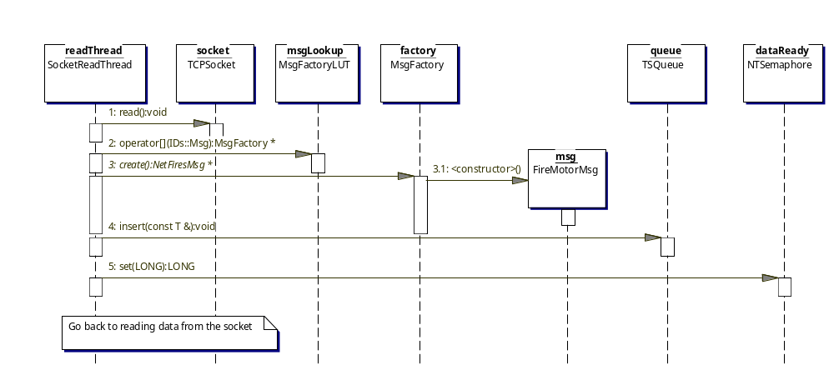
Message Reception
Notes:
The sequence is as follows:
The read thread reads data from some communication device
The ID of the message is extracted from the data read and a call to the message LookUp Table [LUT] is made to get the factory that corresponds to that message ID
The factory creates the concrete message
The new message is inserted into a thread-safe queue
A data-ready semaphore is set to a signaled state
The read thread goes back to waiting for data to arrive

Slide 22
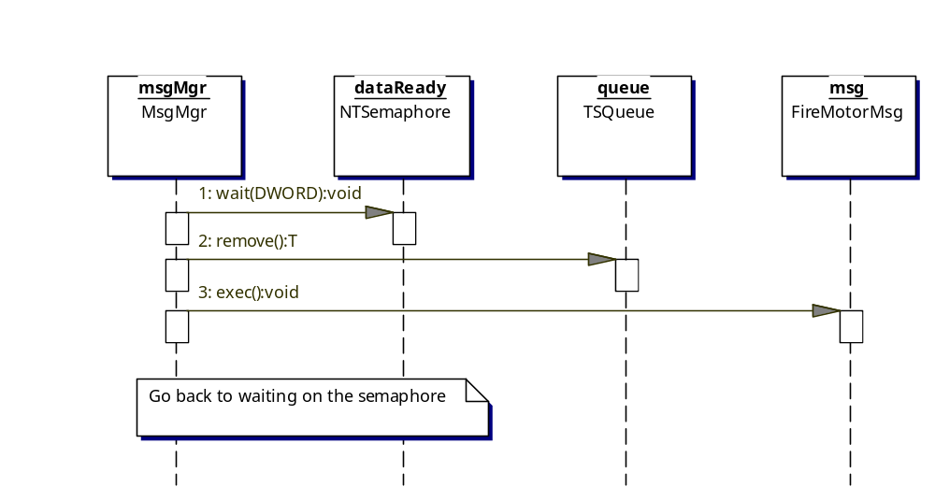
Message Processing
Notes:
The sequence is as follows:
The message manager – in its own thread – waits on the data-ready semaphore
Once the semaphore is in the signaled state, a message is removed from the thread-safe queue
The exec() member function is called on the new message (not shown here is the message manager deleting the message since it was created on the heap by the read thread)
The message manager then returns to waiting on the data-ready semaphore

Slide 23
Other Design Areas
The entire software system was decomposed into OO subsystems and components
These components formed building blocks
Larger components were constructed via containment
  Processes contained threads
  Threads contained communication mechanisms and received messages (among other things)
Unnecessary coupling was mostly avoided
  But...some crept in due to laziness
Notes:
This architecture worked due to a high degree of separation of concerns and component construction via containment and aggregation.

Slide 24
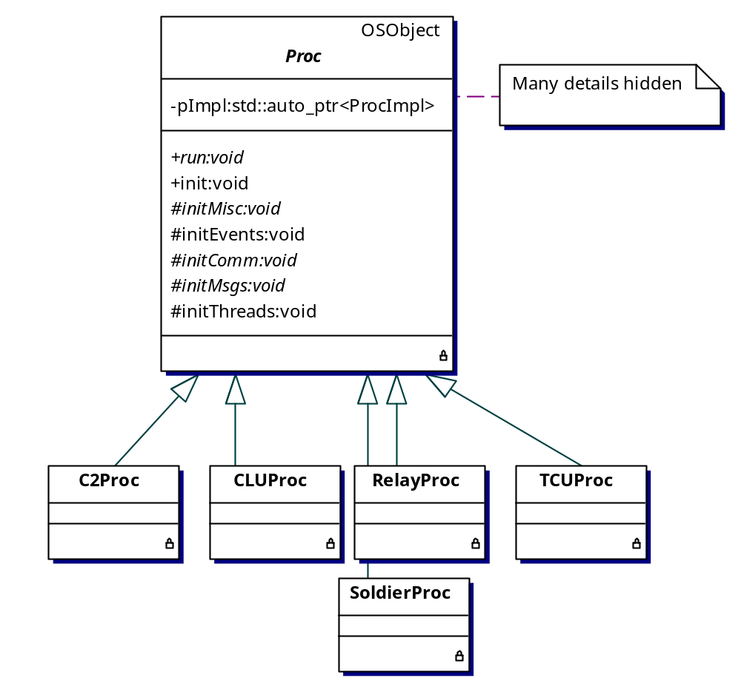
Processes
A single image (i.e., binary) was used to ease maintenance
Process-specific code was placed in derived process classes
A command line argument selected which derived process class got instantiated
Notes:
Process classes held a container of threads and were responsible for managing them in a uniform manner.

Slide 25
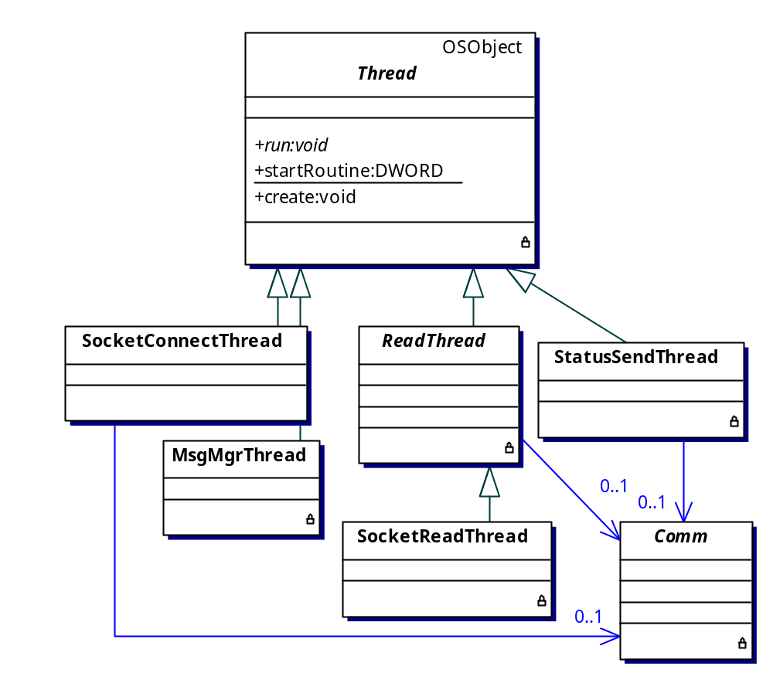
Threads
Threads that use Comm classes don’t know (or care about) what physical communications mechanism is being used
Read threads only need to know where the ID is in the message in order to process them
Notes:
The user could easily create a new thread by deriving off the Thread base class and overriding the run() member function.

Slide 26
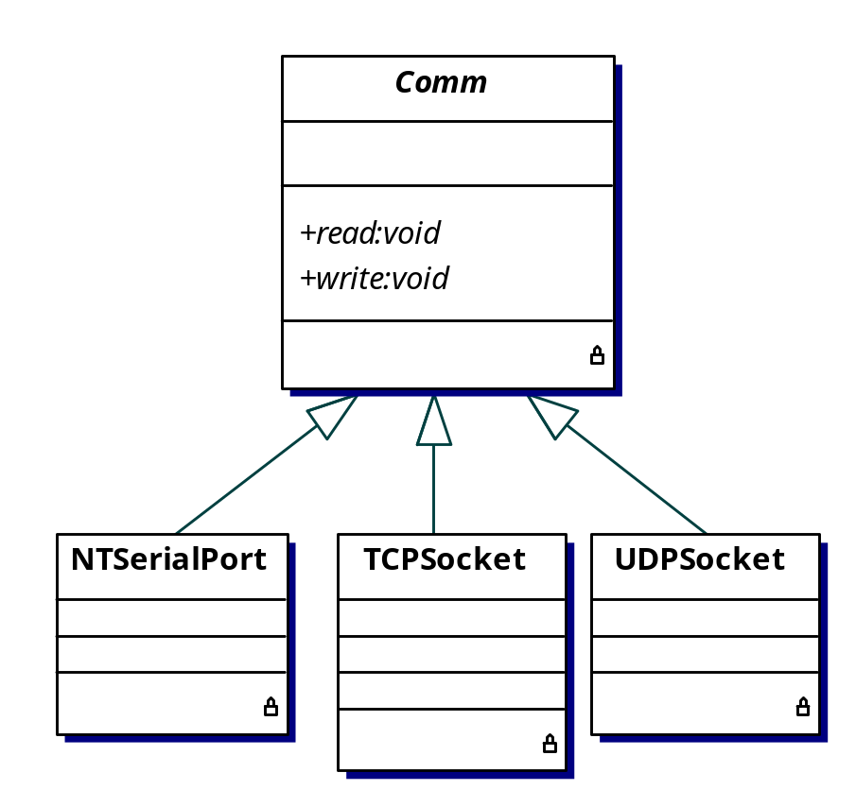
Communications
Derived Comm classes only need to override the read() and write() member functions
Clients can send data via any mechanism that has a concrete class
Comm classes know nothing about classes in the message hierarchy
  This reduces coupling
Notes:
Clients needing to read data from some source only had to deal with the read()/write() member functions making the client code more generic.

Slide 27
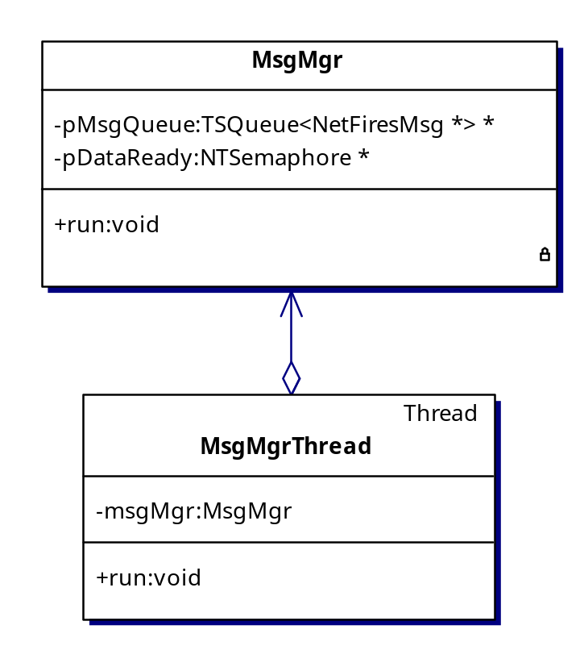
The Message Manager
A message processor becomes trivial (excluding error handling)
This approach scales well if additional message manager thread need to be added
while (!done) {
waitForData();
Msg *pMsg = getMsgFromQueue();
pMsg->exec();
}
Notes:
The message manager only needs to know that the messages it processes have an exec() member function. As a result, the message manager does not need to be modified when new messages are added.

Slide 28
Flexibility Results
Need a new requirement? Create a new derived message and factory classes
Need to change a requirement? Modify code in one location (the derived message class)
Requirements allocation involves registering expected message for a given process
A second message manager thread was needed far into the coding phase
  This involved one line of C++ code and one line in an input file (used by a Perl script to generate code)

Slide 29
Other Techniques
Scripts were used to generate code
  ~30% of the architecture’s C++ code was generated with Perl scripts
  Message headers and IDs were defined as input text files to code generating scripts
Compiler firewall, or bridge design pattern^{[2]}, decoupled changes in header files from other subsystems
STL containers used to facilitate fast and consistent iteration over elements
C++ streaming was used to simplify writing messages to an archive file

Slide 30
Tradeoffs
Pros
  The architecture is applicable to other message passing systems
  Developers are insulated from architecture details
  Adding or removing requirements are isolated in a single hierarchy
  Changes can be implemented quickly
  Message reception is decoupled from message processing
  Action code for a requirement is localized in a single location
Cons
  This creates a shallow and wide hierarchy
  A change in the message base class will cause many files to recompile
  The abstract factory pattern requires a factory class for each message class
    This could be automated

Slide 31

Recipe For Design
Start with abstract concepts
  By definition they lack details
  These form the base classes
Formulate system operation on abstract types
  Message processing becomes generic (via dynamic binding)
Determine variability points
  Allocate variability to derived classes
Identify recurrent patterns or study existing patterns as a design aid
Assign requirements to concrete message classes
Stir vigorously for a year on 350° F until fully baked

Slide 32
Conclusion
The project’s ground software architecture is virtually free of requirements
Flexibility is preserved in the face of volatile requirements
The developer is freed from the underlying (architectural) details
Design and code reuse has been high
Massively buzzword-compliant system
Identification and management of variability, with the techniques presented, facilitates rapid deployment and shorter modification times

Slide 33
Abstract Factory
Creating and Cloning Objects

Slide 34
Background
The Command design pattern has the unique property of delaying execution time from creation time
  Initialization code can create command pattern objects while other code – deep in the bowels of the system – can make the polymorphic calls to derived classes
Advantage: you can delay assigning action code till more information is available
Disadvantage: the creation code is not polymorphic like the execution code
  This leads to dreaded switch/if statements on object types
    My God...the humanity!

Slide 35
Motivation
Runtime polymorphism allows us to avoid specifying concrete member functions at runtime
But, objects cannot be created in a similar polymorphic fashion
  Typically, objects are created in a switch statement...exactly the thing we try to avoid
  One author’s suggestion is that if you start writing code testing one type against another you should “slap yourself in the head”
    But, he supplies no other solution
C++ does not provide a mechanism directly in the language
So, we have a hierarchy with virtual member for when the objects are created but no (blatantly obvious) way to create them

Slide 36
Solution
We need something that does not place all the types to be created into a single location
  That increases coupling
Given a hierarchy, object factories build functionality that will
  Provide C-like functions that strictly create derived object on the free store
  Have a factory class that
    Allows registration of creation functions (i.e., callbacks)
    Stores an association of object IDs to callbacks
    Provides a way to invoke the creation of a derived object via the ID mentioned above

Slide 37
Sample Problem
We have the unmistakably useless Shape hierarchy to illustrate the problem
  This has the ANSI standard Shape base class with mostly stimulating Line, Circle, and Square derived classes, all with a virtual draw() member function
It is required that we instantiate all the derived classes, but
  Not all in the same place and
  We allow for more derived Shapes to be created easily

Slide 38
The Shape Hierarchy
struct Shape {
virtual ~Shape() { }
virtual void draw() = 0;
};
struct Line : public Shape {
virtual void draw() { std::cout << "Line\n"; }
};
struct Circle : public Shape {
virtual void draw() { std::cout << "Circle\n"; }
};
struct Square : public Shape {
virtual void draw() { std::cout << "Square\n"; }
};

Slide 39
Sample Implementation: #1
Note: This implementation is only for creating shapes
First, we need to come up with some way to identify objects
  An enum is an obvious choice
// in IDs.hpp, or some such
enum ShapeID {
LINE,
CIRCLE,
SQUARE,
NUM_SHAPE_IDS
};

Slide 40
Sample Implementation: #1
Next, we define shape-creating callbacks
  The will most likely be in the split into the files that need them
namespace {
Shape *createLine() { return new Line; }
Shape *createCircle() { return new Circle; }
Shape *createSquare() { return new Square; }
}

Slide 41
Sample Implementation: #1
The ShapeFactory has these member functions
  Register shape, passing in an ID and callback
  Create shape, based on an ID
It has one data member
  A std::map containing IDs as the keys and callbacks as the values

Slide 42
Sample Implementation: #1
The ShapeFactory only does a couple things
  Register/unregister shapes
  Create shape
class ShapeFactory {
public:
typedef Shape *(*CreateShapeCallback)();
typedef std::map<ShapeID, CreateShapeCallback> CallbackMap;
ShapeFactory();
bool registerShape(ShapeID id, CreateShapeCallback createFunc);
bool unregisterShape(ShapeID id);
Shape *createShape(ShapeID id);
private:
CallbackMap callbacks_;
};
Notes:
// the details...
class ShapeFactory {
public:
typedef Shape *(*CreateShapeCallback)();
typedef std::map<ShapeID, CreateShapeCallback> CallbackMap;
ShapeFactory() : callbacks_() { }
bool registerShape(ShapeID id, CreateShapeCallback createFunc) {
return (callbacks_[id] = createFunc);
}
bool unregisterShape(ShapeID id) {
// std::map::erase() returns number ereased
return (callbacks_.erase(id) == 1);
}
Shape *createShape(ShapeID id) {
CallbackMap::iterator i(callbacks_.find(id));
if (i == callbacks_.end())
{
throw std::runtime_error("Unknown Shape ID");
}
return (i->second)();
}
private:
CallbackMap callbacks_;
};

Slide 43
Sample Implementation: #1
Using the ShapeFactory looks like
ShapeFactory sf;
sf.registerShape(LINE, createLine);
sf.registerShape(CIRCLE, createCircle);
sf.registerShape(SQUARE, createSquare);
// some other place
Shape *pShape = sf.createShape(LINE);
pShape->draw();
delete pShape;
pShape = sf.createShape(CIRCLE);
pShape->draw();
delete pShape;
pShape = sf.createShape(SQUARE);
pShape->draw();
delete pShape;
pShape = sf.createShape(static_cast<ShapeID>(666));
Notes:
// the details...
class ShapeFactory {
public:
typedef Shape *(*CreateShapeCallback)();
typedef std::map<ShapeID, CreateShapeCallback> CallbackMap;
ShapeFactory() : callbacks_() { }
bool registerShape(ShapeID id, CreateShapeCallback createFunc) {
return (callbacks_[id] = createFunc);
}
bool unregisterShape(ShapeID id) {
// std::map::erase() returns number ereased
return (callbacks_.erase(id) == 1);
}
Shape *createShape(ShapeID id) {
CallbackMap::iterator i(callbacks_.find(id));
if (i == callbacks_.end())
{
throw std::runtime_error("Unknown Shape ID");
}
return (i->second)();
}
private:
CallbackMap callbacks_;
};

Slide 44
Sample Implementation #2
The Loki library has a generic object factory
As one might guess, it is a class template with four template parameters
It allows for the creation of arbitrary types
  The previous implementation only created Shapes
Also included is an error handling policy as a template argument
Notes:
template<class AbstractProduct,
typename IdentifierType,
typename ProductCreator = AbstractProduct* (*)(),
template<typename, class>
class FactoryErrorPolicy = DefaultFactoryError>
class Factory : public FactoryErrorPolicy<IdentifierType, AbstractProduct> {
public:
bool Register(const IdentifierType& id, ProductCreator creator) {
return associations_.insert(
typename IdToProductMap::value_type(id, creator)).second;
}
bool Unregister(const IdentifierType& id) {
return associations_.erase(id) == 1;
}
AbstractProduct* CreateObject(const IdentifierType& id) {
typename IdToProductMap::iterator i = associations_.find(id);
if (i != associations_.end()) {
return (i->second)();
}
return this->OnUnknownType(id);
}
private:
typedef AssocVector<IdentifierType, ProductCreator> IdToProductMap;
IdToProductMap associations_;
};

Slide 45
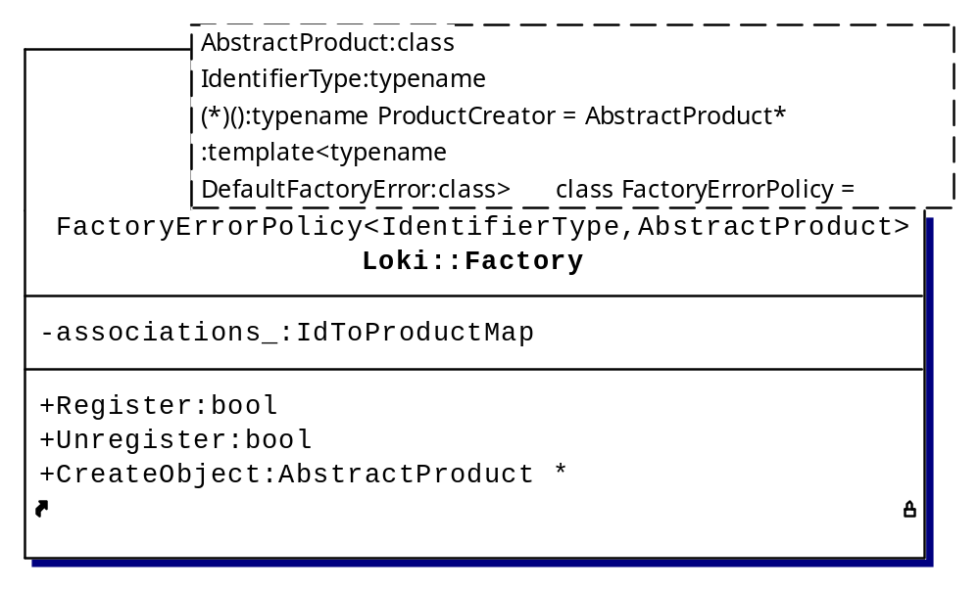
Sample Implementation #2

Slide 46
Sample Implementation #2
Using the Loki factory looks like
typedef Loki::Factory<Shape, ShapeID> ShapeFactoryType;
ShapeFactoryType factory;
factory.Register(LINE, createLine);
factory.Register(CIRCLE, createCircle);
factory.Register(SQUARE, createSquare);
Shape *pShape = factory.CreateObject(LINE);
pShape->draw();
delete pShape;
pShape = factory.CreateObject(CIRCLE);
pShape->draw();
delete pShape;
pShape = factory.CreateObject(SQUARE);
pShape->draw();
delete pShape;
pShape = factory.CreateObject(static_cast<ShapeID>(666));

Slide 47
Containers o’ Pointers & Copying
Problem background
  Given a class hierarchy (w/ base class Shape) and a container holding base class pointers (e.g., std::vector<Shape*> myVec) containing objects of derived types
    myVec.push_back(new Circle);
  How do you copy this container?
  We need a deep copy
struct A {
A(const A &copy) :
myShapes(copy.myShapes) // oops, pointer aliasing {
}
std::vector<Shape*> myShapes;
};

Slide 48
What’s the Problem
Now we have two objects that hold pointers to the same free store allocated data
When one object goes out of scope or is deleted, it (typically) deallocates free store allocated objects
  This is OK so far
If the second object – using the same pointers – goes out of scope, or gets deallocated, the same, already deallocated, pointers get deallocated a second time
Bang...undefined behavior

Slide 49
An Inflexible Solution
One may be tempted by Satan to do something like this
Demon of testing against types, be gone!
What’s a trendy programmer to do? Return of the clones!
if (typeid(myObject) == typeid(Derived1))
// create & copy a Derived1
else if (typeid(myObject) == typeid(Derived2))
// create & copy a Derived2
// ...

Slide 50
Copying Solution
Create a virtual clone() member function
  For each derived type, it returns “new DerivedType”
But wait, isn’t the return type going to be different for each derived clone() function?
  Indeed, we take advantage of a C++ feature called covariant return types
  Each derived class returns a pointer to its own type
What’s it look like?

Slide 51
Copying Solution
The Shape hierarchy looks like
Birds are singing, order is restored to the universe, you smile at people going slow in the fast lane
struct Shape {
// ...
virtual Shape *clone() const = 0;
};
struct Circle : public Shape {
// ...
virtual Circle *clone() const {
return new Circle(*this);
}
};
// other concrete shapes

Slide 52
Deep Thoughts
The object factory pattern eliminates switch statements on different types, consequently
  Files become more decoupled
  There’s no file that contain #includes for all your factory types
  Maintenance is simplified
We can copy objects safely using covariant returns types and a virtual clone member function
  Maintenance is again simplified

Slide 53
Additional Material
→ C++ STL
→ Testing and You

Slide 54
STL Motivation
A huge collection of code has been written by people who have no life and make a career from writing libraries
  They did the work so we don’t need to reinvent the wheel
  Programs are more portable by not relying on vendor or user-specific libraries
  Considerable attention has been paid to performance
    “You don’t pay for what you don’t use”
The Standard C++ library is now part of the ISO/IEC 14882 C++ programming language specification (since 1997)
  Uniform look, feel, and smell for library classes (interfaces)
More concise and efficient code can be written using the STL

Slide 55
Yet More Motivation
Most compilers supply a Standard C++ library for free
If you don’t like your compiler vendor’s library, other options exist
  STLport (http://www.stlport.org/) is free
  SGI (http://www.sgi.com/tech/stl/) is free
  Dinkumware (http://www.dinkumware.com/) costs money
    With a name like Dinkumware, you know its got to be good!

Slide 56
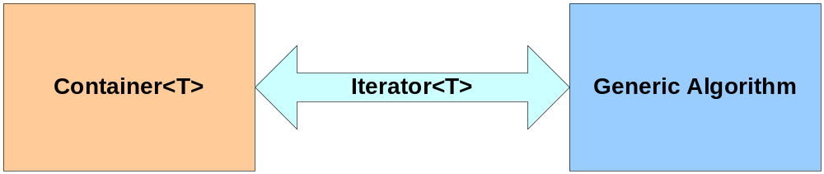
C++ STL
The STL is a collection of generic containers, algorithms, and iterators
  Sequence containers: list, vector (ie, array), and deque (pronounced dek)
  Associative containers: set, and map (like a hash), ...
  Algorithms: sort, find, transform, ...
  Iterators are the interface between containers and algorithms

Slide 57
Big-Oh Notation
The computation time of most algorithms is of interest to some/most people
A simple parameter - n, the number of elements in a container - is used to categorize computation time
For inputs of size n, we consider the maximum time, T(n), the algorithm takes (time as a function of n)
For some function f such that T(n) <= cf(n), for some constant c and all sufficiently large n, we write T(n) <= O(f(n))
The five main cases of interest are
  T(n) = O(n), the algorithm is said to have linear time bound, or more simply linear
  T(n) = O(n²), the algorithm is said to have quadratic time bound
  T(n) = O(log n), the algorithm is said to have logarithmic time bound
  T(n) = O(n log n), the algorithm is said to have n log n time bound
  T(n) = O(1), the algorithm is said to have constant time bound
Notes:
This is one of the few times where a programming language standard explicitly states performance characteristics.
Andrew Koenig from comp.lang.c++.moderated:
Saying f(n) = O(n) means that there exists a value k such that
f(n) <= k * n for all n > 0. So if we say that something costs O(n), it means that there exists a k such that if:
n == 1, executing the operation costs no more than k
n == 2, executing the operation costs no more than 2*k
n == 3, executing the operation costs no more than 3*k

Slide 58
Pop Quiz
What does the function stats() do?
template<typename T>
struct Sum : public std::unary_function<T, T> {
Sum() : sum_(0) {}
T operator()(T value) { return sum_ += value; }
T sum_;
};
void stats(const DubVec &v) {
Sum<double> sum1 = std::for_each(v.begin(), v.end(), Sum<double>());
double average = sum1.sum_ / v.size(); // ignore divide-by-zero errors
int numPosValues = std::count_if(v.begin(),
v.end(),
std::bind2nd(std::greater<double>(), 0.0));
int numNegValues = std::count_if(v.begin(),
v.end(),
std::bind2nd(std::less<double>(), 0.0));
}
Notes:
With clearly named users types and variables and common STL containers and algorithms, users can get a general understanding of what your code is doing without being library experts.

Slide 59
Testing and You
General good things
  Test early and test often
  Use the compiler to catch errors at compile-time instead of runtime
    assert() is a C/C++ thing that can help
  When working in a team and using a version control program (e.g., CVS, RCS, SCCS, or Subversion)
    Make sure what gets checked in compiles
    Code that does not work will impact others and they may know what car you drive or where you live
  Eat your vegetables

Slide 60
References
[1] Booch, Grady, “Object-Oriented Analysis and Design”, 2nd Edition, Addison-Wesley 1994
[2] Gamma, Erich, et al, “Design Patterns: Elements of Reusable Object-Oriented Software”, Addison-Wesley 1995
[3] ISO/IEC 14882:1998(E), Programming Languages-C++ (ISO & ANSI C++ standard), http://www.ansi.org

Slide 61
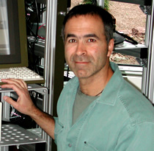
About the Author
Sarir has been programming professionally since 1983 at places such as Lincoln Laboratory, The MathWorks, Motorola, and now Raytheon. His interests include C++ and OOP, Perl, Python, network (socket) programming, architecture design and development, and really loud music.

